Slide 1
Chapter 4
Frequency-domain Representation of LTI Discrete-Time Systems

Slide 2
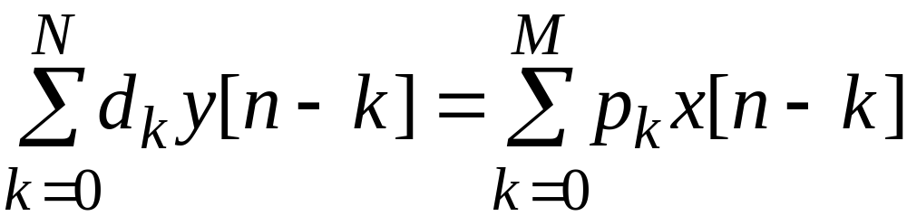
§4.1 LTI Discrete-Time Systems in the Transform Domain
This course is concerned with LTI discrete-time systems characterized by linear constant coefficient difference equations of the form:

Slide 3
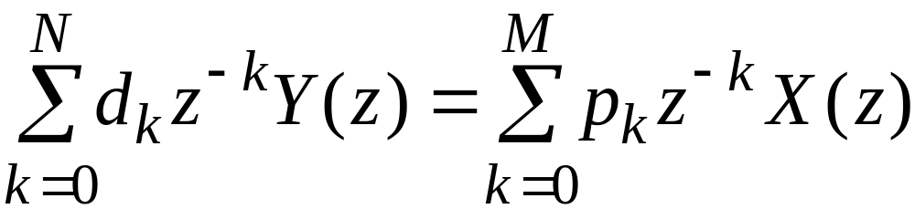
§4.1 LTI Discrete-Time Systems in the Transform Domain
Applying the z-transform to both sides of the difference equation and making use of the linearity and the time-invariance properties we arrive at
where Y(z) and X(z) denote the z-transforms of y[n] and x[n] with associated ROCs, respectively

Slide 4
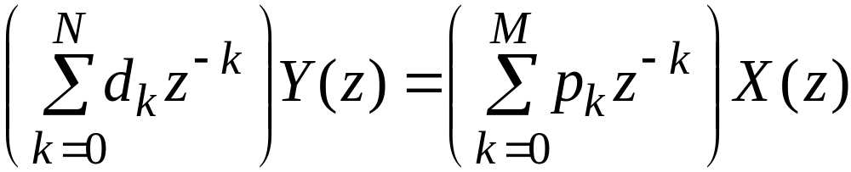
§4.1 LTI Discrete-Time Systems in the Transform Domain
A more convenient form of the z-domain representation of the difference equation is given by

Slide 5
§4.2 The Frequency Response
The quantity H(e^{jω}) is called the frequency response of the LTI discrete-time system
H(e^{jω}) provides a frequency-domain description of the system
H(e^{jω}) is precisely the DTFT of the impulse response {h[n]} of the system

Slide 6
§4.2 The Frequency Response
H(e^{jω}), in general, is a complex function of ω with a period 2π
It can be expressed in terms of its real and imaginary parts
H(e^{jω})= H_{re}(e^{jω}) +j H_{im}(e^{jω})
or, in terms of its magnitude and phase,
H(e^{jω})=|H(e^{jω})| e^{θ(ω)}
where
θ(ω)=argH(e^{jω})

Slide 7
§4.2 The Frequency Response
The function | H(e^{jω}) | is called the magnitude response and the function θ(ω) is called the phase response of the LTI discrete-time system
Design specifications for the LTI discrete-time system, in many applications, are given in terms of the magnitude response or the phase response or both

Slide 8
§4.2 The Frequency Response
In some cases, the magnitude function is specified in decibels as
G(ω) = 20log₁₀| H(e^{jω}) | dB
where G(ω) is called the gain function
The negative of the gain function
A(ω) = - G(ω)
is called the attenuation or loss function

Slide 9
§4.2 The Frequency Response
Note: Magnitude and phase functions are real functions of ω, whereas the frequency response is a complex function of ω
If the impulse response h[n] is real then the magnitude function is an even function of ω:
|H(e^{jω})| = |H(e ⁻ ^{jω})|
and the phase function is an odd function of ω:
θ(ω) = - θ(-ω)

Slide 10
§4.4 The Concept of Filtering
One application of an LTI discrete-time system is to pass certain frequency components in an input sequence without any distortion (if possible) and to block other frequency components
Such systems are called digital filters and one of the main subjects of discussion in this course

Slide 11
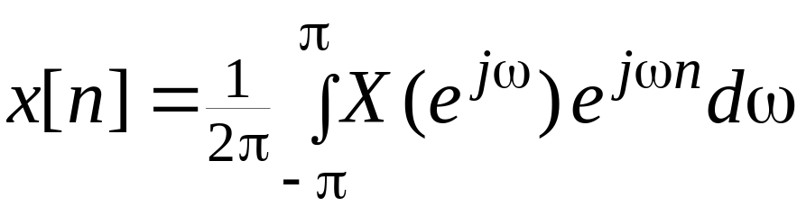
§4.4 The Concept of Filtering
The key to the filtering process is
It expresses an arbitrary input as a linear weighted sum of an infinite number of exponential sequences, or equivalently, as a linear weighted sum of sinusoidal sequences

Slide 12
§4.4 The Concept of Filtering
Thus, by appropriately choosing the values of the magnitude function |H(e^{jω})| of the LTI digital filter at frequencies corresponding to the frequencies of the sinusoidal components of the input, some of these components can be selectively heavily attenuated or filtered with respect to the others

Slide 13
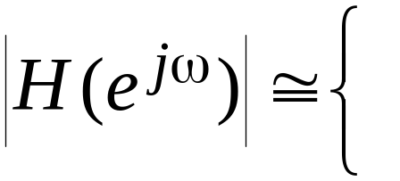
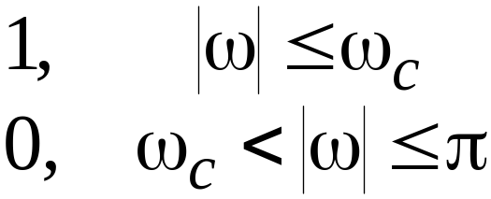
§4.4 The Concept of Filtering
To understand the mechanism behind the design of frequency-selective filters, consider a real-coefficient LTI discrete-time system characterized by a magnitude function

Slide 14
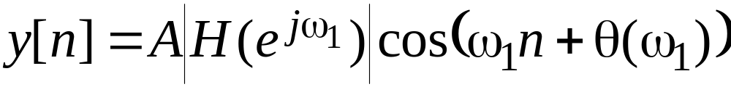
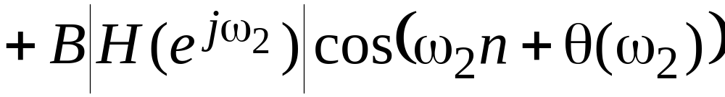
§4.4 The Concept of Filtering
We apply an input
x[n]=Acosω₁n+Bcosω₂n, 0< ω₁< ω_{c}< ω₂<π
to this system
Because of linearity, the output of this system is of the form

Slide 15
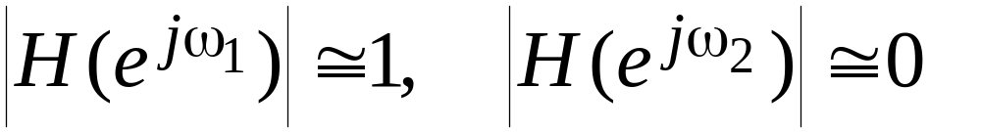
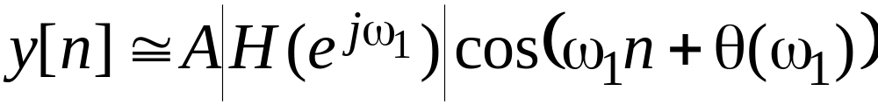
§4.4 The Concept of Filtering
As
the output reduces to
Thus, the system acts like a lowpass filter
In the following example, we consider the design of a very simple digital filter

Slide 16
§4.4 The Concept of Filtering
Thus the output-input relation of the FIR filter is given by
y[n] = - 6.76195(x[n]+x[n-2])+13.456335x[n-1]
where the input is
x[n] = {cos(0.1n) + cos(0.4n)}μ[n]
Program 4_2 can be used to verify the filtering action of the above system

Slide 17
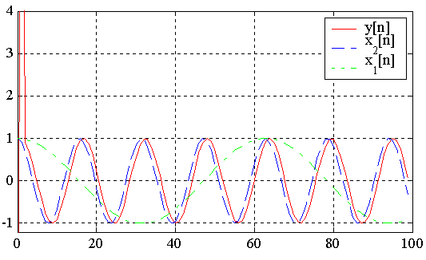
§4.4 The Concept of Filtering
Figure below shows the plots generated by running this program

Slide 18
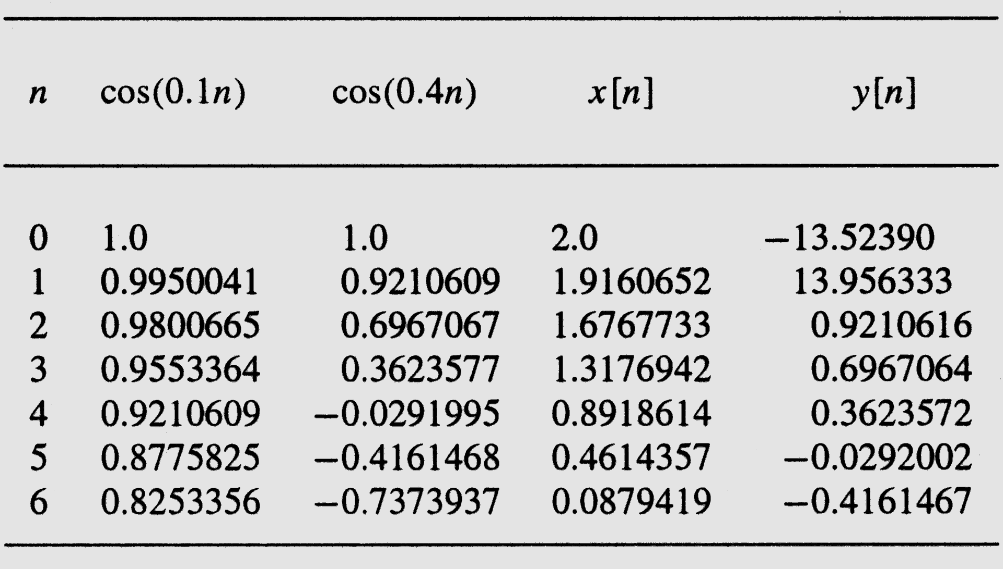
§4.4 The Concept of Filtering
The first seven samples of the output are shown below

Slide 19
§4.4 The Concept of Filtering
From this table, it can be seen that, neglecting the least significant digit,
y[n] = cos(0.4(n-1)) for n ≥ 2
Computation of the present value of the output requires the knowledge of the present and two previous input samples
Hence, the first two output samples, y[0] and y[1], are the result of assumed zero input sample values at n = -1 and n = -2

Slide 20
§4.4 The Concept of Filtering
Therefore, first two output samples constitute the transient part of the output
Since the impulse response is of length 3, the steady-state is reached at n = N = 2
Note also that the output is delayed version of the high-frequency component cos(0.4n) of the input, and the delay is one sample period

Slide 21
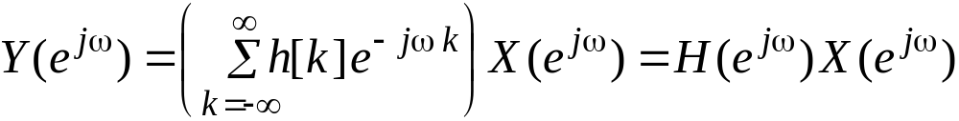
§4.6 Frequency Response of the LTI Discrete-Time System
Hence, we can write
H(e ^{jω}) is the frequency response of the LTI system
The above equation relates the input and the output of an LTI system in the frequency domain

Slide 22
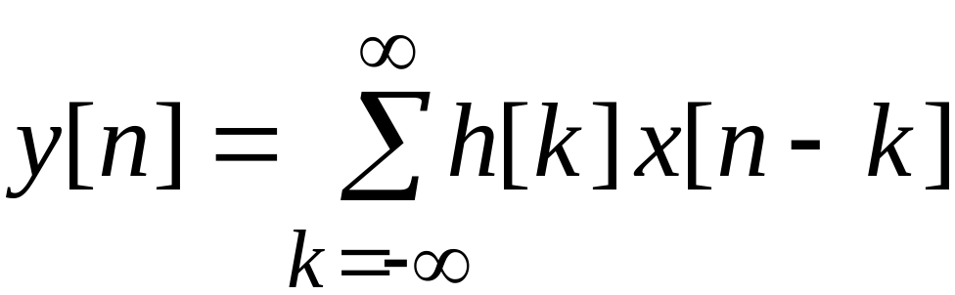
§4.7 The Transfer Function
A generalization of the frequency response function
The convolution sum description of an LTI discrete-time system with an impulse response h[n] is given by

Slide 23
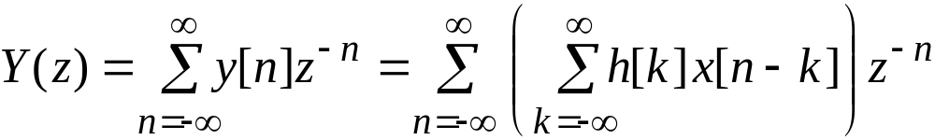
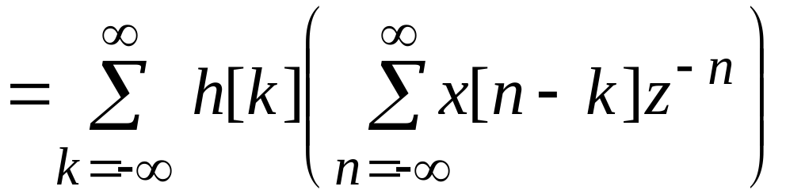
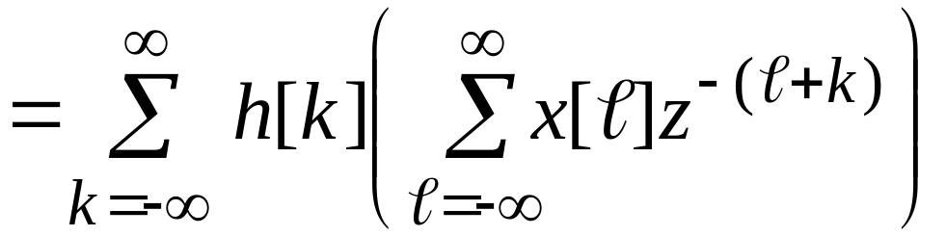
§4.7 The Transfer Function
Taking the z-transforms of both sides we get

Slide 24
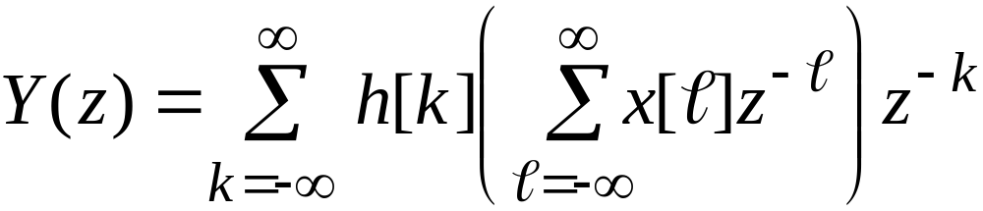

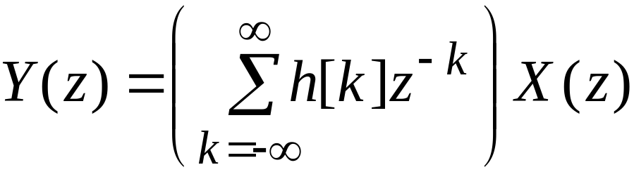

§4.7 The Transfer Function
Or,
Therefore,
Thus, Y(z) = H(z)X(z)

Slide 25
§4.7 The Transfer Function
Hence,
H(z) = Y(Z)/X(z)
The function H(z), which is the z-transform of the impulse response h[n] of the LTI system, is called the transfer function or the system function
The inverse z-transform of the transfer function H(z) yields the impulse response h[n]

Slide 26
Homework
Read the textbook from p.203 to 233, and from 243 to 248
Problems
4.2, 4.5, 4.7, 4.8, 4.12, 4.19, 4.26, 4.29，4.32，

